Slide 1
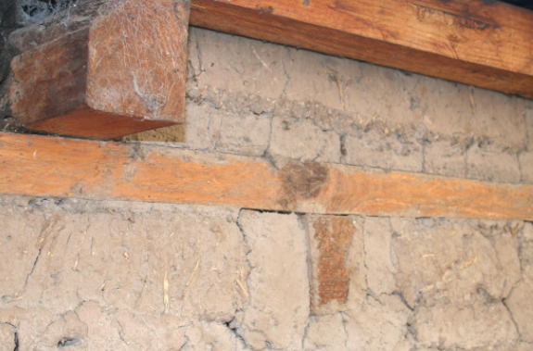
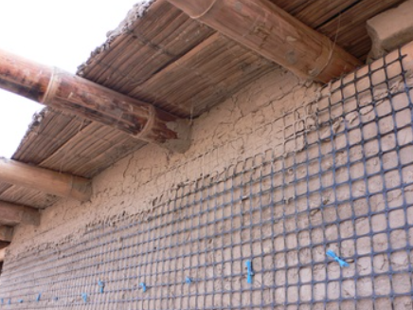
Improving Seismic Resistance of ADOBE Construction
SEISMIC REINFORCEMENT
Earthquake shaking causes adobe walls to crack at the corners and break up in large blocks. The use of reinforcement such as Ring Beam ties the walls in a box-like structure and keeps the adobe wall together.
Additional wall reinforcement made up of strong ductile materials such as bamboo, barbed wires or steel bars should also be provided.
Fig: Ring Beam
Fig: Wall Reinforcement

Slide 2
Improving Seismic Resistance of ADOBE Construction (Cont.)
Vertical reinforcement helps to tie the wall to the foundation and to the ring beam and restrains out-of-plane bending and in-plane shear.
Horizontal reinforcement helps to transmit the out-of-plane forces in transverse walls to the supporting shear walls, restrain the shear stresses between adjoining wall and even minimize vertical crack propagation.
The horizontal and vertical reinforcement should be tied together and to the structural elements to provide stable matrix for maintaining the integrity of the walls even after they have been broken into larger pieces.

Slide 3
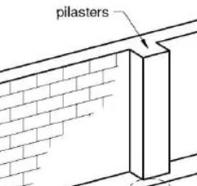
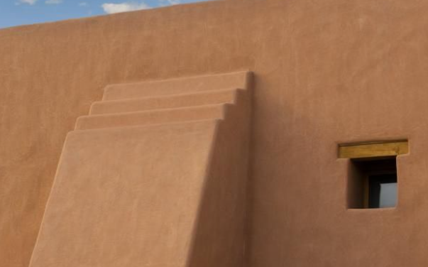
Improving Seismic Resistance of ADOBE Construction (Cont.)
Also, the use of buttresses and pilasters in the critical parts of the structure increases stability and stress resistance. Buttresses act as counter supports preventing inward and outward overturning of the wall.
Fig: Buttress
Fig: Pilaster

Slide 4
Improving Seismic Resistance of ADOBE Construction (Cont.)
OTHER CONSIDERATIONS
The following recommendations will be useful for achieving earthquake
resistant abode houses;
Build only one-storey houses
Using insulated lightweight roof instead of heavy roof.
Keeping the openings in the walls small and well spaced.
Building on firm soil and providing a concrete or stone foundation.

Slide 5
Seismic Strengthening of Existing ADOBE Houses
Dynamic tests conducted by researchers in Peru have demonstrated that a good solution for existing adobe houses is an external reinforcement consisting of wide strips of wire mesh (1mm wires spaced at ¾ inches) nailed with metallic bottle caps against the adobe wall.
The mesh is placed in horizontal and vertical strips simulating beams and columns. It is then covered with cement and sand mortar.
During 2001 earthquake in the south of Peru, several houses reinforced with this technique didn’t suffer any damage but similar unreinforced houses suffered significant damages.
The Getty Conservation Institute carried out a project to develop technical procedures to prevent the structural instability of historic adobe buildings during earthquake with minimal intervention to their original fabric.

Slide 6
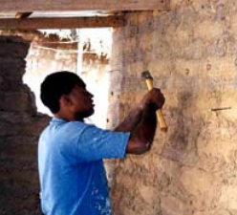
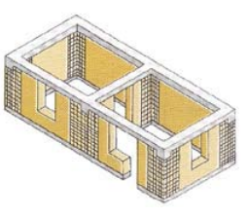
Seismic Strengthening of Existing ADOBE Houses
Nine small-scale and two large-scale model buildings were subjected to shaking table tests for comparing different reinforcement systems.
An effective retrofit system was developed, consisting of straps made of woven nylon placed horizontally or vertically, forming loops around the entire building or around individual walls. Nylon cross-ties were added to hold these straps.
Vertical steel rods drilled directly into the adobe walls were effective in delaying and limiting both the in-plane and out-of-plane wall damage.
Fig: Nailing the wire mesh
Fig: Layout of the wire mesh reinforcement

